Slide 1
What Is the Disease of Obesity?
Obesity, the Chronic Disease

Slide 2
Obesity Meets AMA Criteria for a Disease
Impairment of Normal Function
Characteristic Signs or Symptoms
Harm or Morbidity
  Physical impairments
  Altered physiologic function (inflammation, insulin resistance, dyslipidemia, etc)
  Altered regulation of satiety in the hypothalamus
  Increased body fat mass
  Joint pain
  Impaired mobility
  Low self-esteem
  Sleep apnea
  Altered metabolism
  Cardiovascular disease
  Type 2 diabetes
  Metabolic syndrome
  Cancer
  Death
AMA = American Medical Association.
Mechanick JI, et al. Endocr Pract. 2012;18:642-648.

Slide 3
Definition of Obesity
Obesity is a complex, multifactorial disease characterized by excess body fat/adiposity
Criteria for a disease
  Impairment of normal functioning
  Characteristic signs or symptoms
  Harm or morbidity
Obesity is a disease with multiple pathophysiological aspects, including genetic, environmental, physiological, and psychological factors
Mechanick JI, et al. Endocr Pract. 2012;18:642-648.
Notes:
So what is obesity? Different sources have different definitions ranging from the simple “excess adiposity” to the more nuanced including a complex description. In 2012 AACE asserted obesity is a disease and published a position statement emphasizing the fulfilling of criteria to be categorized as a disease
But what about diagnosis? How do we decide who has obesity and who should be treated at what level of intensity? I’ll go through some cases to frame what we propose

Slide 4
Chronic Disease Management as Applied to Obesity
Intervention phase | Definition and goals | Method
Primary Prevention | Prevent development of overweight and obesity | Educate the public Modify obesogenic built environment Promote healthy eating and regular physical activity
Secondary Prevention | Prevent future weight gain and development of weight-related complications in patients with overweight or obesity | Screen using BMI Diagnose using BMI and evaluation for complications Treat with lifestyle/behavioral interventions ± weight loss medications
Tertiary Prevention | Treat with weight-loss therapy to eliminate or ameliorate weight-related complications and prevent disease progression | Treat with lifestyle/behavioral interventions plus weight loss medications Consider bariatric surgery
Garvey TW, et al. Endocr Pract. 2016;22(suppl 3):1-205.

Slide 5
Medical Complications of Obesity
Obesity
Biomechanical
Cardiometabolic
Other
Dismotility/disability
GERD
Lung function
defects
Osteoarthritis
Sleep apnea
Urinary
incontinence
Dyslipidemia
Hypertension
Androgen deficiency
Cancer
Gallstone disease
Psychological
disorders
Prediabetic states
NAFLD
PCOS
Diabetes
Cardiovascular Disease
GERD = gastroesophageal reflux disease; NAFLD = nonalcoholic fatty liver disease; PCOS = polycystic ovary syndrome.
Pi-Sunyer X. Postgrad Med. 2009;121:21-33.

Slide 6
Obesity-Related Abnormalities: Mechanical Problems
Breathing disorders (sleep apnea, asthma)
Osteoarthritis
Urinary stress incontinence
GERD
GERD = gastroesophageal reflux disease.
Garvey TW, et al. Endocr Pract. 2016;22(suppl 3):1-205.

Slide 7
Obesity-Related Abnormalities:
Metabolic and Organ Dysfunction
Appetite dysregulation
Abnormal energy balance
Endocrine dysfunction
  Elevated leptin levels
  Insulin resistance
Dysregulated adipokine signaling
Abnormal endothelial function
Hypertension
Infertility
Nonalcoholic fatty liver disease (NAFLD)
Dyslipidemia
Systemic inflammation
Adipose tissue inflammation
GERD = gastroesophageal reflux disease.
Garvey TW, et al. Endocr Pract. 2016;22(suppl 3):1-205.

Slide 8
Obesity Has Multiple Pathophysiologic Origins
Epigenetic
Environmental
Genetic
Obesity
Sociocultural
Physiologic
Behavioral
Bray GA, et al. Lancet. 2016;387:1947-1956.

Slide 9
Worldwide Trends
Epidemiology of Obesity

Slide 10


Slide 11
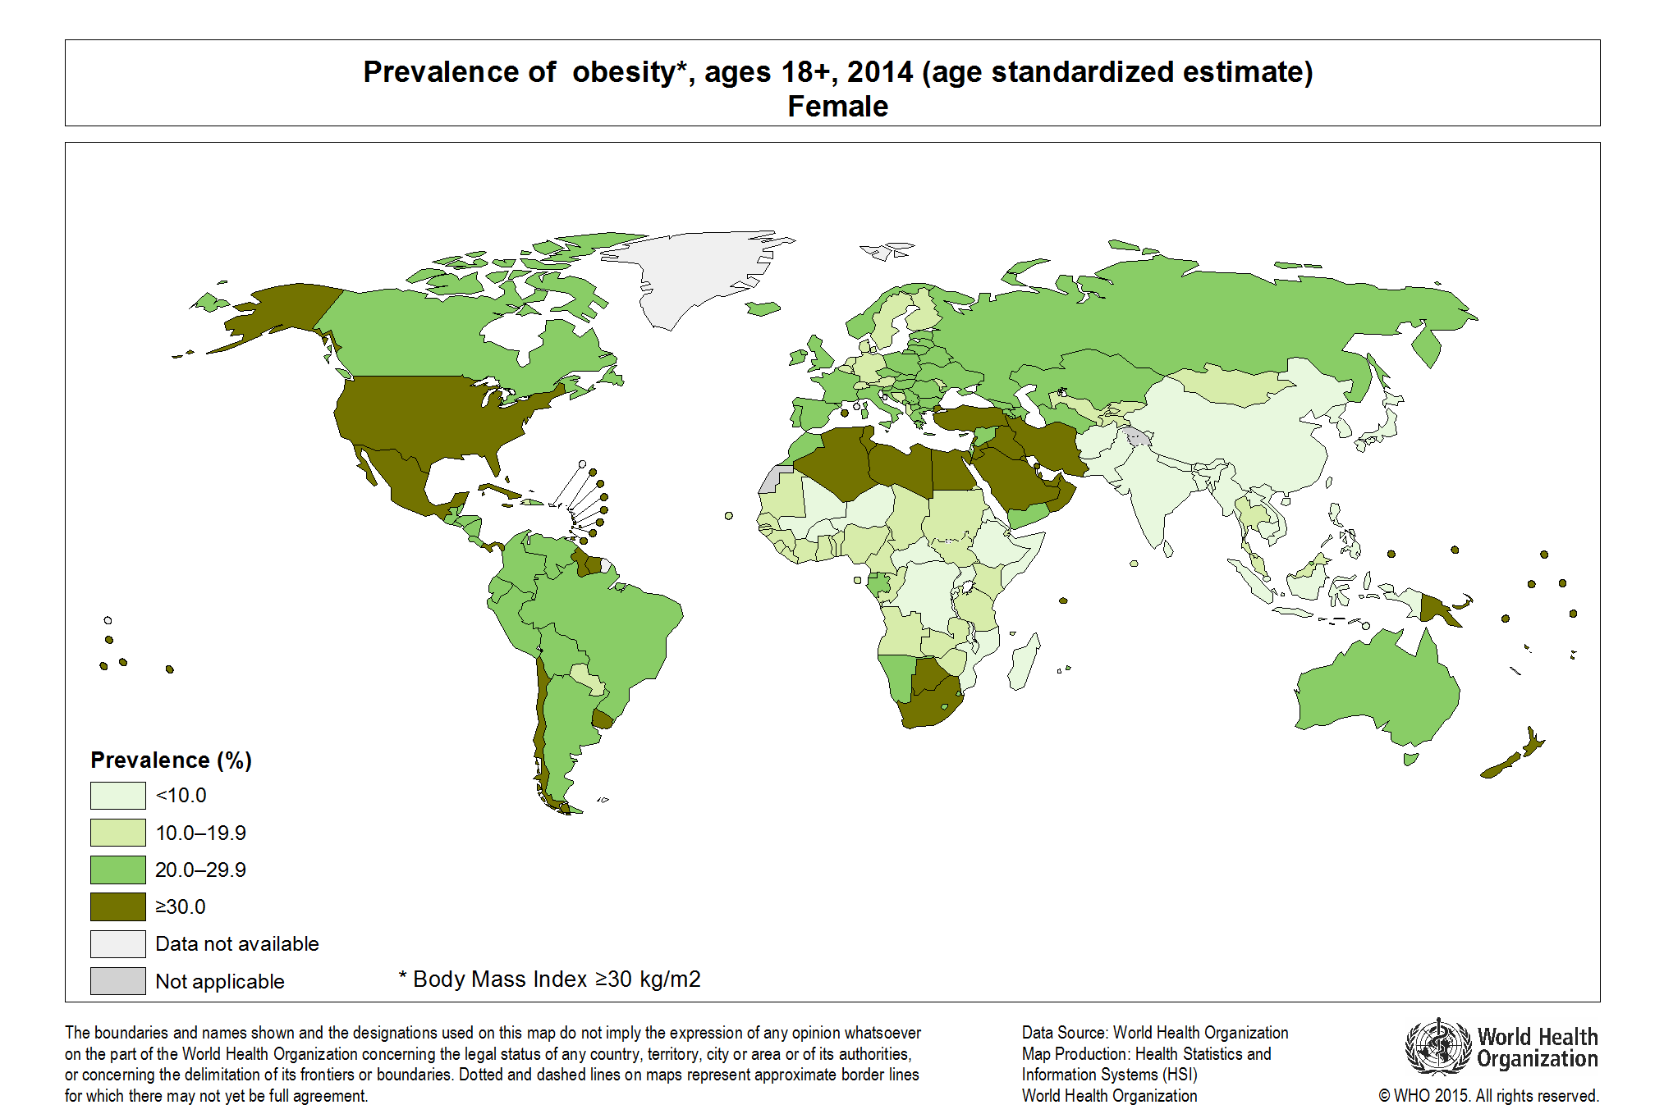
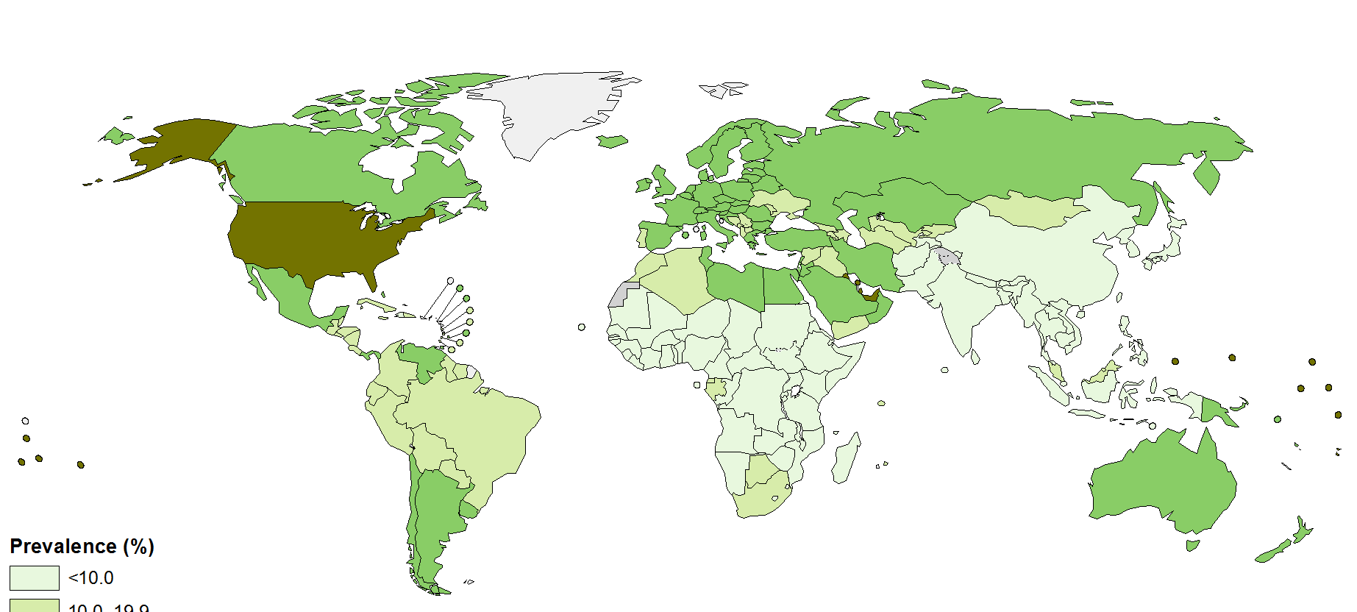
Worldwide Prevalence of Obesity
2015
Women, Age ≥18 Years
BMI ≥30 kg/m²
<10.0%
10.0%-19.9%
20.0%-29.9%
≥30%
Data not available
Not applicable
Men, Age ≥18 Years
WHO. Global Health Observatory Map Gallery. Available at: http://gamapserver.who.int/mapLibrary/app/searchResults.aspx.

Slide 12
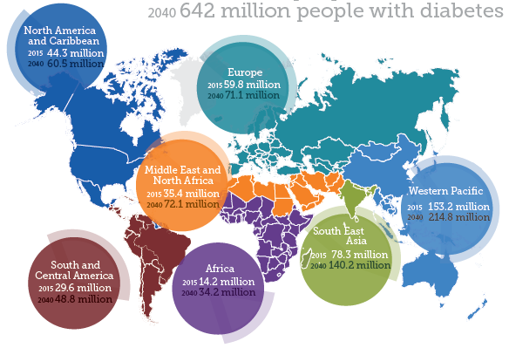
Obesity Increase Is Associated with Rising Rates of Diabetes Worldwide
Current estimated prevalence: 415 million worldwide
By 2040, 642 million people worldwide are expected to have diabetes
IDF. Diabetes Atlas Update 2015. Available at: http://www.idf.org/sites/default/files/Atlas7e-poster.pdf.

Slide 13
Strong Association Between Weight Gain and Diabetes: Rural India
Obesity*
Diabetes
750% increase
191% increase
*BMI ≥25 kg/m².
BMI = body mass index.
Ramachandran A, et al. Diabetologia. 2004;47:860-865.

Slide 14
The Increase in Diabetes Parallels the Increase in Obesity in the United States
Obesity*
Diabetes
96% increase
43% increase
Population (%)
*BMI ≥30 kg/m².
BMI = body mass index.
CDC. National diabetes statistics report, 2014. Atlanta, GA: US Department of Health and Human Services, Centers for Disease Control and Prevention, 2014. Mokdad AH, et al. JAMA. 1999;282:1519-1522; Mokdad AH, et al. Diabetes Care. 2000;23:1278-1283; Ogden CL, et al. JAMA. 2014;311:806-814.

Slide 15
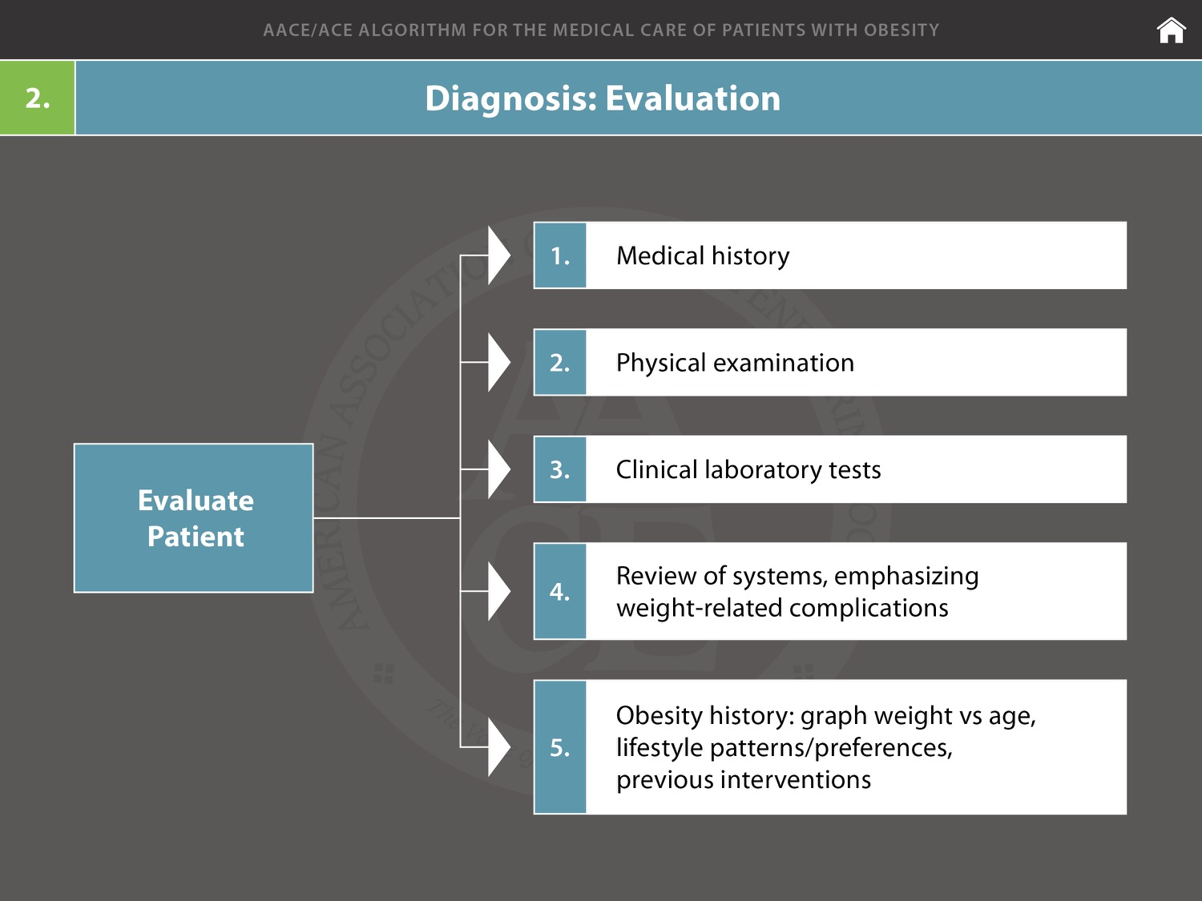

Slide 16
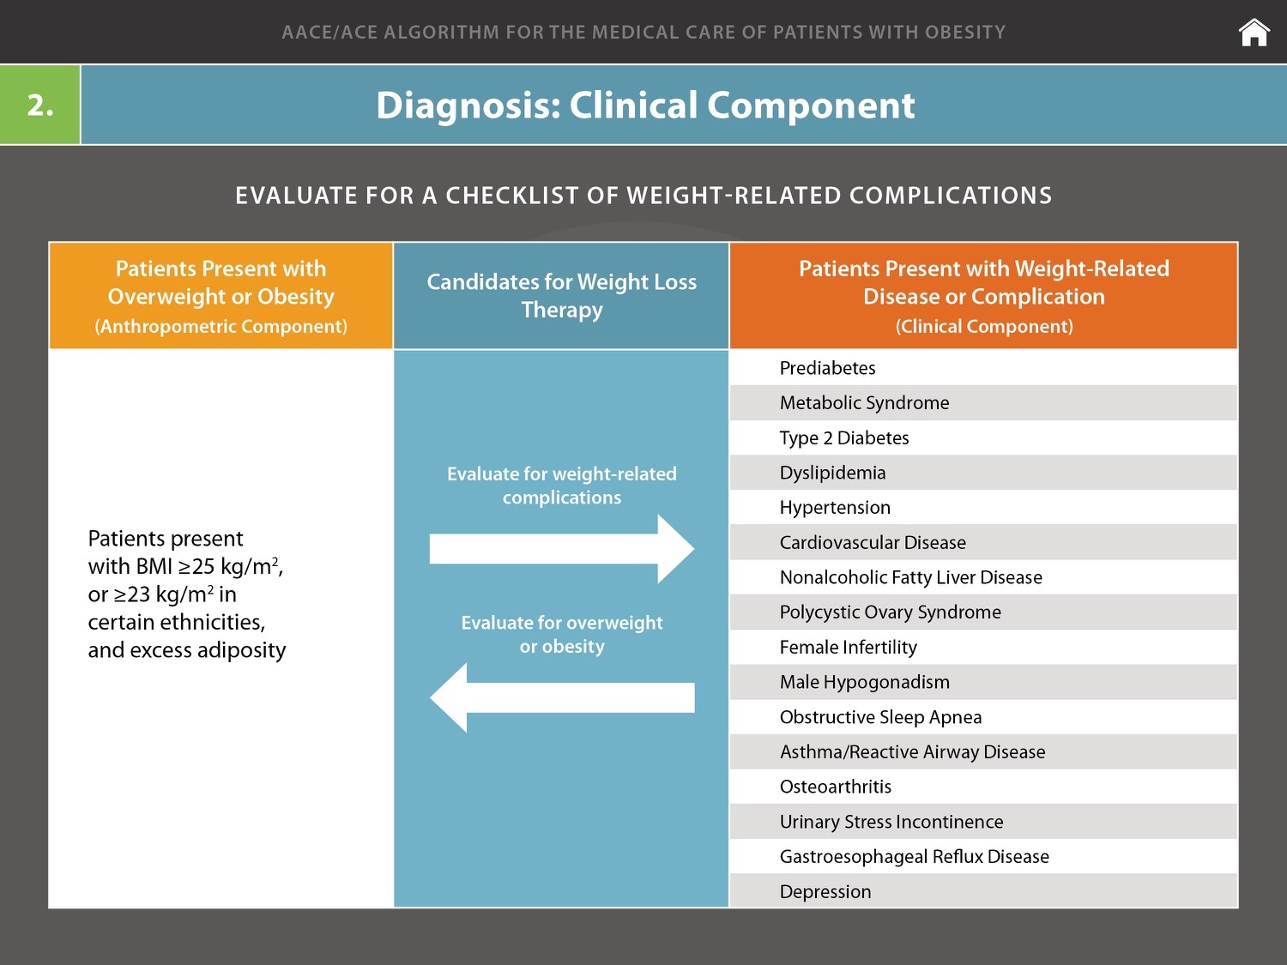

Slide 17


An In-Depth Look at the 2015-2020 Dietary Guidelines
Information adapted from the 2015-2020 Dietary Guidelines for Americans. Available at DietaryGuidelines.gov.
Notes:
Available at: DietaryGuidelines.gov
The 2015-2020 Dietary Guidelines is available exclusively on DietaryGuidelines.gov. In the coming months, the U.S. Government Publishing Office will release a printed edition and a downloadable PDF will become available online.
Suggested Citation
U.S. Department of Health and Human Services and U.S. Department of Agriculture. 2015 – 2020 Dietary Guidelines for Americans. 8th Edition. December 2015. Available at http://health.gov/dietaryguidelines/2015/guidelines/.

Slide 18
Nutrition and Health Are Closely Related
“About half of all American adults—117 million individuals—have one or more preventable chronic diseases, many of which are related to poor eating and physical activity patterns.”
Notes:
About half of all American adults—117 million individuals—have one or more preventable chronic diseases, many of which are related to poor quality eating patterns and physical inactivity. These include cardiovascular disease, high blood pressure, type 2 diabetes, some cancers, and poor bone health. More than two-thirds of adults and nearly one-third of children and youth are overweight or obese. These high rates of overweight and obesity and chronic disease have persisted for more than two decades and come not only with increased health risks, but also at high cost. In 2008, the medical costs associated with obesity were estimated to be $147 billion. In 2012, the total estimated cost of diagnosed diabetes was $245 billion, including $176 billion in direct medical costs and $69 billion in decreased productivity.
[See Table I-1 for additional facts about Nutrition- and Physical Activity-Related Health Conditions in the United States.]

Slide 19
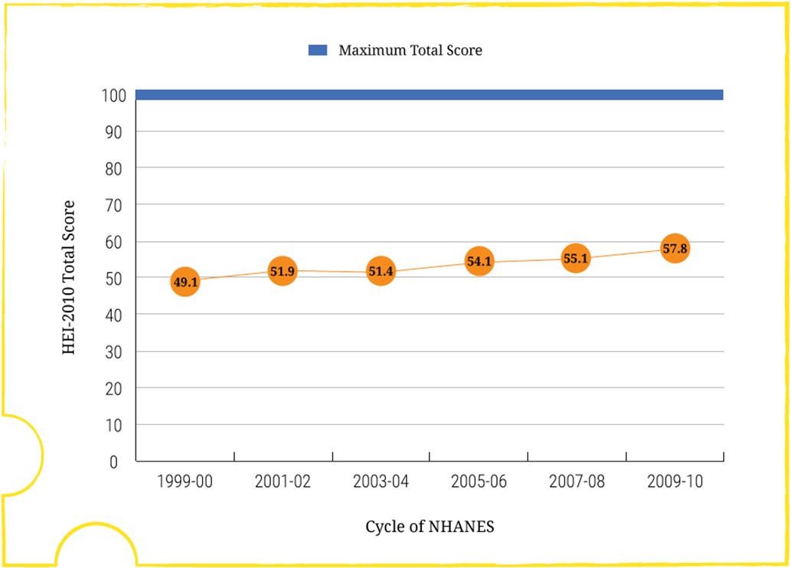
Adherence to the 2010 Dietary Guidelines
Measured by Average Total Healthy Eating Index-2010 (HEI-2010) Scores of the U.S. Population Ages 2 Years and Older (Figure I-1)
Data Source: Analyses of What We Eat in America, National Health and Nutrition Examination Survey (NHANES) data from 1999-2000 through 2009-2010.
Note: HEI-2010 total scores are out of 100 possible points. A score of 100 indicates that recommendations on average were met or exceeded. A higher total score indicates a higher quality diet.
Notes:
Concurrent with these diet-related health problems persisting at high levels, trends in food intake over time show that, at the population level, Americans are not consuming healthy eating patterns. For example, the prevalence of overweight and obesity has risen and remained high for the past 25 years, while Healthy Eating Index (HEI) scores, a measure of how food choices align with the Dietary Guidelines, have remained low (Figure I-1).

Slide 20
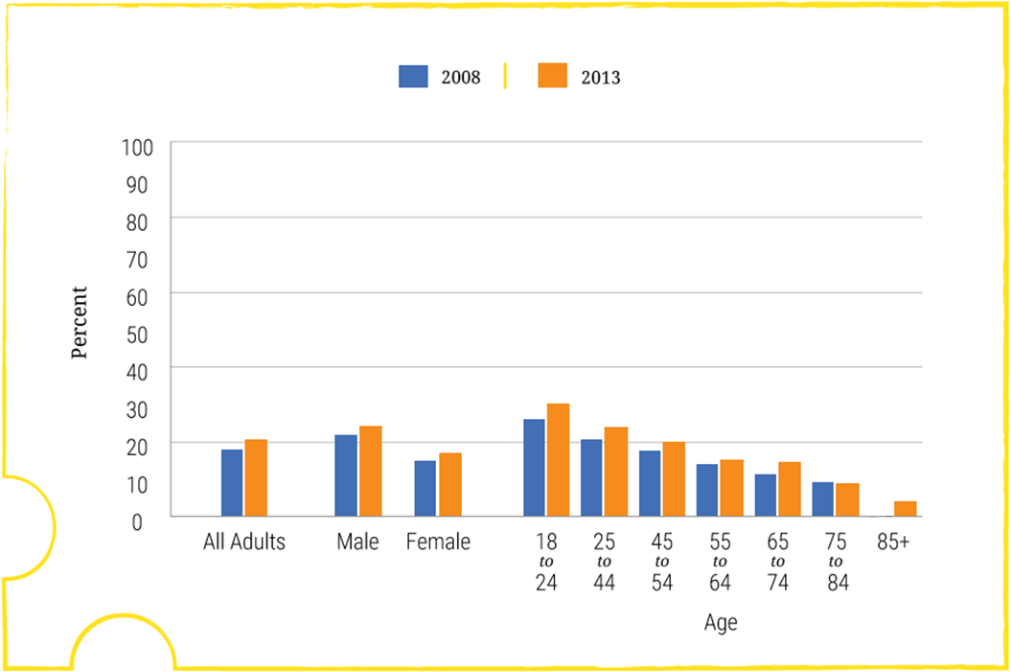
Adherence to the Physical Activity Guidelines
Percentage of Adults Meeting the Aerobic and Muscle-Strengthening Recommendations (Figure I-2)
Data Source:
Analyses of the National Health Interview Survey, 2008 and 2013.
Healthy People 2020 PA-2.4. Increase the proportion of adults who meet the objectives for aerobic physical activity and for muscle-strengthening activity. Washington, DC: U.S. Department of Health and Human Services, Office of Disease Prevention and Health Promotion, June 3, 2015. Available at: http://www.healthypeople.gov/2020/data-search/Search-the-Data?nid=5072.
Notes:
Similarly, physical activity levels have remained low over time (Figure I-2). The continued high rates of overweight and obesity and low levels of progress toward meeting Dietary Guidelines recommendations highlight the need to improve dietary and physical activity education and behaviors across the U.S. population.
Progress in reversing these trends will require comprehensive and coordinated strategies, built on the Dietary Guidelines as the scientific foundation, that can be maintained over time. The Dietary Guidelines is an important part of a complex and multifaceted solution to promoting health and helping to reduce the risk of chronic disease.

Slide 21
2015-2020 Dietary Guidelines for Americans:
The Guidelines
Follow a healthy eating pattern across the lifespan. All food and beverage choices matter. Choose a healthy eating pattern at an appropriate calorie level to help achieve and maintain a healthy body weight, support nutrient adequacy, and reduce the risk of chronic disease.
Focus on variety, nutrient density, and amount. To meet nutrient needs within calorie limits, choose a variety of nutrient-dense foods across and within all food groups in recommended amounts.
Limit calories from added sugars and saturated fats and reduce sodium intake. Consume an eating pattern low in added sugars, saturated fats, and sodium. Cut back on foods and beverages higher in these components to amounts that fit within healthy eating patterns.
Notes:
The 2015-2020 Dietary Guidelines for Americans provides five overarching Guidelines that encourage healthy eating patterns, recognize that individuals will need to make shifts in their food and beverage choices to achieve a healthy pattern, and acknowledge that all segments of our society have a role to play in supporting healthy choices.

Slide 22
2015-2020 Dietary Guidelines for Americans:
The Guidelines (cont.)
Shift to healthier food and beverage choices. Choose nutrient-dense foods and beverages across and within all food groups in place of less healthy choices. Consider cultural and personal preferences to make these shifts easier to accomplish and maintain.
Support healthy eating patterns for all. Everyone has a role in helping to create and support healthy eating patterns in multiple settings nationwide, from home to school to work to communities.
Notes:
The 2015-2020 Dietary Guidelines for Americans provides five overarching Guidelines that encourage healthy eating patterns, recognize that individuals will need to make shifts in their food and beverage choices to achieve a healthy pattern, and acknowledge that all segments of our society have a role to play in supporting healthy choices.

Slide 23

Key Elements of Healthy Eating Patterns:
Key Recommendations
Consume a healthy eating pattern that accounts for all foods and beverages within an appropriate calorie level.
A healthy eating pattern includes:
A variety of vegetables from all of the subgroups—dark green, red and orange, legumes (beans and peas), starchy, and other
Fruits, especially whole fruits
Grains, at least half of which are whole grains
Fat-free or low-fat dairy, including milk, yogurt, cheese, and/or fortified soy beverages
A variety of protein foods, including seafood, lean meats and poultry, eggs, legumes (beans and peas), and nuts, seeds, and soy products
Oils
A healthy eating pattern limits:
Saturated fats and trans fats, added sugars, and sodium
Notes:
These five Guidelines are supplemented with a number of Key Recommendations that provide more specific guidance on healthy eating patterns.
The Dietary Guidelines’ Key Recommendations for healthy eating patterns should be applied in their entirety, given the interconnected relationship that each dietary component can have with others.
Consume a healthy eating pattern that accounts for all foods and beverages within an appropriate calorie level.
A healthy eating pattern includes:
A variety of vegetables from all of the subgroups—dark green, red and orange, legumes (beans and peas), starchy, and other
Fruits, especially whole fruits [Whole fruits include fresh, canned, dried, or frozen fruits.]
Grains, at least half of which are whole grains [When refined grains are chosen, they should be enriched.]
Fat-free or low-fat dairy, including milk, yogurt, cheese, and/or fortified soy beverages [Increasing the proportion of dairy intake that is fat-free or low-fat milk or yogurt and decreasing the proportion that is cheese would decrease saturated fats and sodium and increase potassium, vitamin A, and vitamin D provided from the dairy group.]
A variety of protein foods, including seafood, lean meats and poultry, eggs, legumes (beans and peas), and nuts, seeds, and soy products
Oils [Oils include: canola, corn, olive, peanut, safflower, soybean, and sunflower oils. Oils also are naturally present in nuts, seeds, seafood, olives, and avocados.]
A healthy eating pattern limits: Saturated fats and trans fats, added sugars, and sodium [More information about these components to limit is provided on the next slide.]

Slide 24
Key Elements of Healthy Eating Patterns:
Key Recommendations (cont.)
Key Recommendations that are quantitative are provided for several components of the diet that should be limited. These components are of particular public health concern in the United States, and the specified limits can help individuals achieve healthy eating patterns within calorie limits:
Consume less than 10 percent of calories per day from added sugars
Consume less than 10 percent of calories per day from saturated fats
Consume less than 2,300 milligrams (mg) per day of sodium
If alcohol is consumed, it should be consumed in moderation—up to one drink per day for women and up to two drinks per day for men—and only by adults of legal drinking age
Meet the Physical Activity Guidelines for Americans
Notes:
Chapter 1 also includes discussion of the quantitative Key Recommendations for several components of the diet that should be limited. These components are of particular public health concern in the United States, and the specified limits can help individuals achieve healthy eating patterns within calorie limits:
Consume less than 10 percent of calories per day from added sugars. [The added sugars recommendation is a target based on food pattern modeling and national data on intakes of calories from added sugars. This target demonstrates the public health need to limit calories from added sugars to meet food group and nutrient needs within calorie limits. When added sugars exceed 10% of calories, a healthy eating pattern may be difficult to achieve.]
Consume less than 10 percent of calories per day from saturated fats. [The recommendation to consume less than 10 percent of calories per day as saturated fats is a target based on evidence that replacing saturated fats with unsaturated fats is associated with reduced risk of cardiovascular disease. However, replacing saturated fats with carbohydrates is not associated with reduced risk of cardiovascular disease.]
Consume less than 2,300 milligrams per day of sodium. [Americans are encouraged to follow the age- and sex-appropriate Tolerable Upper Intake Levels (ULs) for sodium set by the Institute of Medicine. The UL is 2,300 milligrams per day for individuals ages 14 years and older. The recommendations for children younger than 14 years of age are the IOM age- and sex-appropriate ULs {which vary from 1,500 to 2,200, depending on age}. For adults with hypertension or prehypertension, further reduction to 1,500 mg per day can result in greater blood pressure reduction.]
If alcohol is consumed, it should be consumed in moderation—up to one drink per day for women and up to two drinks per day for men—and only by adults of legal drinking age. [It is not recommended that individuals begin drinking or drink more for any reason, and there are many circumstances in which individuals should not drink, such as during pregnancy.]
In tandem with these recommendations, Americans of all ages—children, adolescents, adults, and older adults—should meet the Physical Activity Guidelines for Americans to help promote health and reduce the risk of chronic disease.
And, Americans should aim to achieve and maintain a healthy body weight.

Slide 25
Principles of Healthy Eating Patterns
An eating pattern represents the totality of all foods and beverages consumed
  It is more than the sum of its parts; the totality of what individuals habitually eat and drink act synergistically in relation to health.
Nutritional needs should be met primarily from foods
  Individuals should aim to meet their nutrient needs through healthy eating patterns that include foods in nutrient-dense forms.
Healthy eating patterns are adaptable
  Any eating pattern can be tailored to the individual’s socio-cultural and personal preferences.
Notes:
The 2015-2020 Dietary Guidelines for Americans reflects for the first time a robust body of scientific evidence on overall eating patterns and chronic disease.
Healthy eating patterns support a healthy body weight and can help prevent and reduce the risk of chronic disease throughout periods of growth, development, and aging as well as during pregnancy. The following principles apply to meeting the Key Recommendations:
An eating pattern represents the totality of all foods and beverages consumed. All foods consumed as part of a healthy eating pattern fit together like a puzzle to meet nutritional needs without exceeding limits, such as those for saturated fats, added sugars, sodium, and total calories. All forms of foods, including fresh, canned, dried, and frozen, can be included in healthy eating patterns. Eating patterns are more than the sum of their parts and may be more predictive of overall health and disease risk than individual foods or nutrients.
Nutritional needs should be met primarily from foods. Individuals should aim to meet their nutrient needs through healthy eating patterns that include nutrient-dense foods. Foods in nutrient-dense forms contain essential vitamins and minerals and also dietary fiber and other naturally occurring substances that may have positive health effects. In some cases, fortified foods and dietary supplements may be useful in providing one or more nutrients that otherwise may be consumed in less than recommended amounts.
Healthy eating patterns are adaptable. Individuals have more than one way to achieve a healthy eating pattern. Any eating pattern can be tailored to the individual’s socio-cultural and personal preferences.
There is more than one type of healthy eating pattern. The 2015-2020 Dietary Guidelines embodies the idea that a healthy eating pattern is not a rigid prescription, but rather, an adaptable framework in which individuals can enjoy foods that meet their personal, cultural, and traditional preferences and fit within their budget.

Slide 26
Inside Healthy Eating Patterns:
Food Groups
“Eating an appropriate mix of foods from the food groups and subgroups—within an appropriate calorie level—is important to promote health.”
Each food group and subgroup provides an array of nutrients.
Recommended amounts reflect eating patterns associated with positive health outcomes.
Foods from all of the food groups should be eaten in nutrient-dense forms.
Notes:
The 2015-2020 Dietary Guidelines notes that eating an appropriate mix of foods from the food groups and subgroups—within an appropriate calorie level—is important to promote health.
Each of the food groups (vegetables, fruits, grains, dairy, and protein foods) and their subgroups provides an array of nutrients, and the amounts recommended reflect eating patterns that have been associated with positive health outcomes.
Foods from all of the food groups should be eaten in nutrient-dense forms.
The Guidelines describes the recommendations for each of the food groups, highlights nutrients for which the food group is a key contributor, and describes special considerations related to the food group.

Slide 27
Healthy Eating Patterns:
Multiple Approaches
“There are many ways to consume a healthy eating pattern, and the evidence to support multiple approaches has expanded over time.”
Examples of healthy eating patterns in the Dietary Guidelines include:
  Healthy U.S.-Style Eating Pattern
  Healthy Mediterranean-Style Eating Pattern
  Healthy Vegetarian Eating Pattern
Notes:
There are many ways to consume a healthy eating pattern, and the evidence to support multiple approaches has expanded over time.
Throughout the 2015-2020 Dietary Guidelines, the Healthy U.S.-Style Eating Pattern is used to illustrate the specific amounts and limits for food groups and other dietary components that make up healthy eating patterns. The Healthy U.S.-Style Eating Pattern at the 2000-calorie level is illustrated here.
Two additional healthy eating patterns—the Healthy Mediterranean-Style Eating Pattern and the Healthy Vegetarian Eating Pattern—are provided as examples to reflect other styles of eating.
The Healthy Mediterranean-Style Eating Pattern and Healthy Vegetarian Eating Pattern were developed by modifying the Healthy U.S.-Style Eating Pattern. Similar to the Healthy U.S.-Style Eating Pattern, these patterns were designed to consider the types and proportions of foods Americans typically consume, but in nutrient-dense forms and appropriate amounts, which result in eating patterns that are attainable and relevant in the U.S. population.
Appendices to the Guidelines provide detailed information about all three example eating patterns at 12 calorie levels—from 1000 to 3200 calories.
Additionally, healthy eating patterns can be flexible with respect to the intake of carbohydrate, protein, and fat within the context of the AMDR

Slide 28

DietaryGuidelines.gov
Additional Resources:
Health.gov
ChooseMyPlate.gov

Slide 29
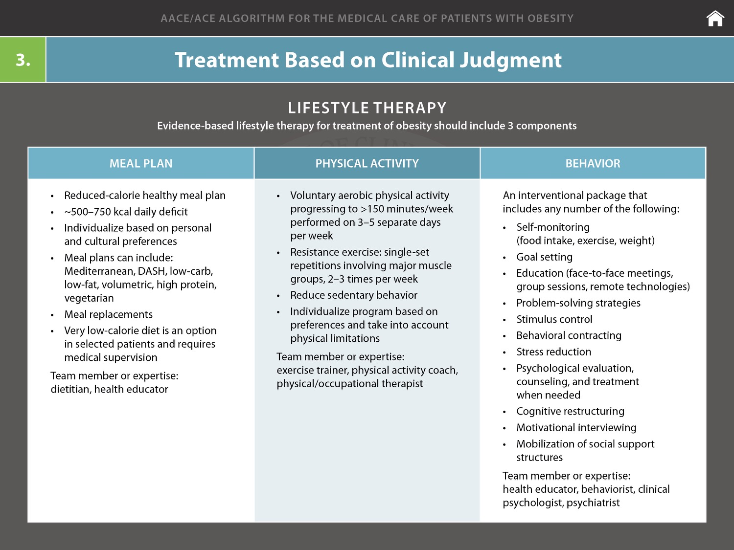

Slide 30
Macronutrient Composition
Meal patterns enriched in the following are associated with a decrease in insulin sensitivity
  Total fat
  Saturated fat
  Trans-fat
  Refined grains
Meal patterns enriched in the following are associated with an increase in insulin sensitivity
  Fiber
  Fruits/vegetables
  Polyunsaturated fats
  Monounsaturated fats
  Whole grain
Gonzalez-Campoy JM, et al. Endocr Pract. 2013;19(suppl 3):1-82.
Garvey WY, Lara-Castro C. J Clin Endocrinol Metab. 2004;89:4197-4205.

Slide 31
Features of Different Types of Meal Plans
Meal Plan | Calories | Composition | Recommended food choices
Dietary Approaches to Stop Hypertension (DASH) | 1600-3100 kcal/day depending on individual needs | ≤27% fat calories. ≤6% saturated fat calories. ≤150 mg/day cholesterol. ≤3 g/day sodium. | Fruits, vegetables, and low-fat dairy foods.
Low-carbohydrate (Atkins) | No restrictions | 20 g/day carbohydrates during 2-month induction phase, with gradual increase to ≤120 g/day carbohydrates. | Vegetarian sources of fat and protein preferred. Avoid trans fat.
Low-fat | Women: 1500 kcal/d Men: 1800 kcal/d | 30% fat calories. ≤10% saturated fat calories. ≤300 mg/day cholesterol. | Low-fat grains, vegetables, fruits, and legumes. Limit sweets and high-fat snacks
Mediterranean | Women: 1500 kcal/d Men: 1800 kcal/d | ≤35% of calories from fat | Vegetables , poultry, and fish. Main fat source: 30-45 g/day olive oil and 5-7 nuts (<20 g/ day). Limited red meat.
Appel LJ, et al. N Engl J Med. 1997;336:1117-1124. Shai I, et al. N Engl J Med. 2008;359:229-241.

Slide 32
Adherence Is More Important Than Meal Plan Type for Weight Loss Success
Weight Change by
Meal Plan Type
Weight Change by
Meal Plan Adherence
r=0.07, P=0.40
r = -0.60, P<0.001
Δ Weight at 12 Months (kg)
Atkins
Zone
Weight Watchers
Ornish
Atkins
Zone
Weight
Watchers
Ornish
Mean Adherence Score
Over 1 Year
Dansinger M. JAMA. 2005;293:43-53.

Slide 33
Effects of Different Diets on Weight
Dietary Intervention Randomized Control Trial (DIRECT)
Study Design
322 overweight or obese adults (85% men)
2-year study duration
Randomized, controlled design
Diet group | Calorie Limit | Fat Limit | Characteristic nutrition sources
Low fat | 1500 for women 1800 for men | 30% | Grains, vegetables, fruits, beans
Mediterranean | 1500 for women 1800 for men | 35% | Olive oil, nuts, vegetables, fish
Low carbohydrate | None | None | 20 g/day of carbohydrate for 2 months, then 120 g/day of carbohydrates Fat, protein, and vegetables
Shai I, et al. N Engl J Med. 2008;359:229-241.

Slide 34
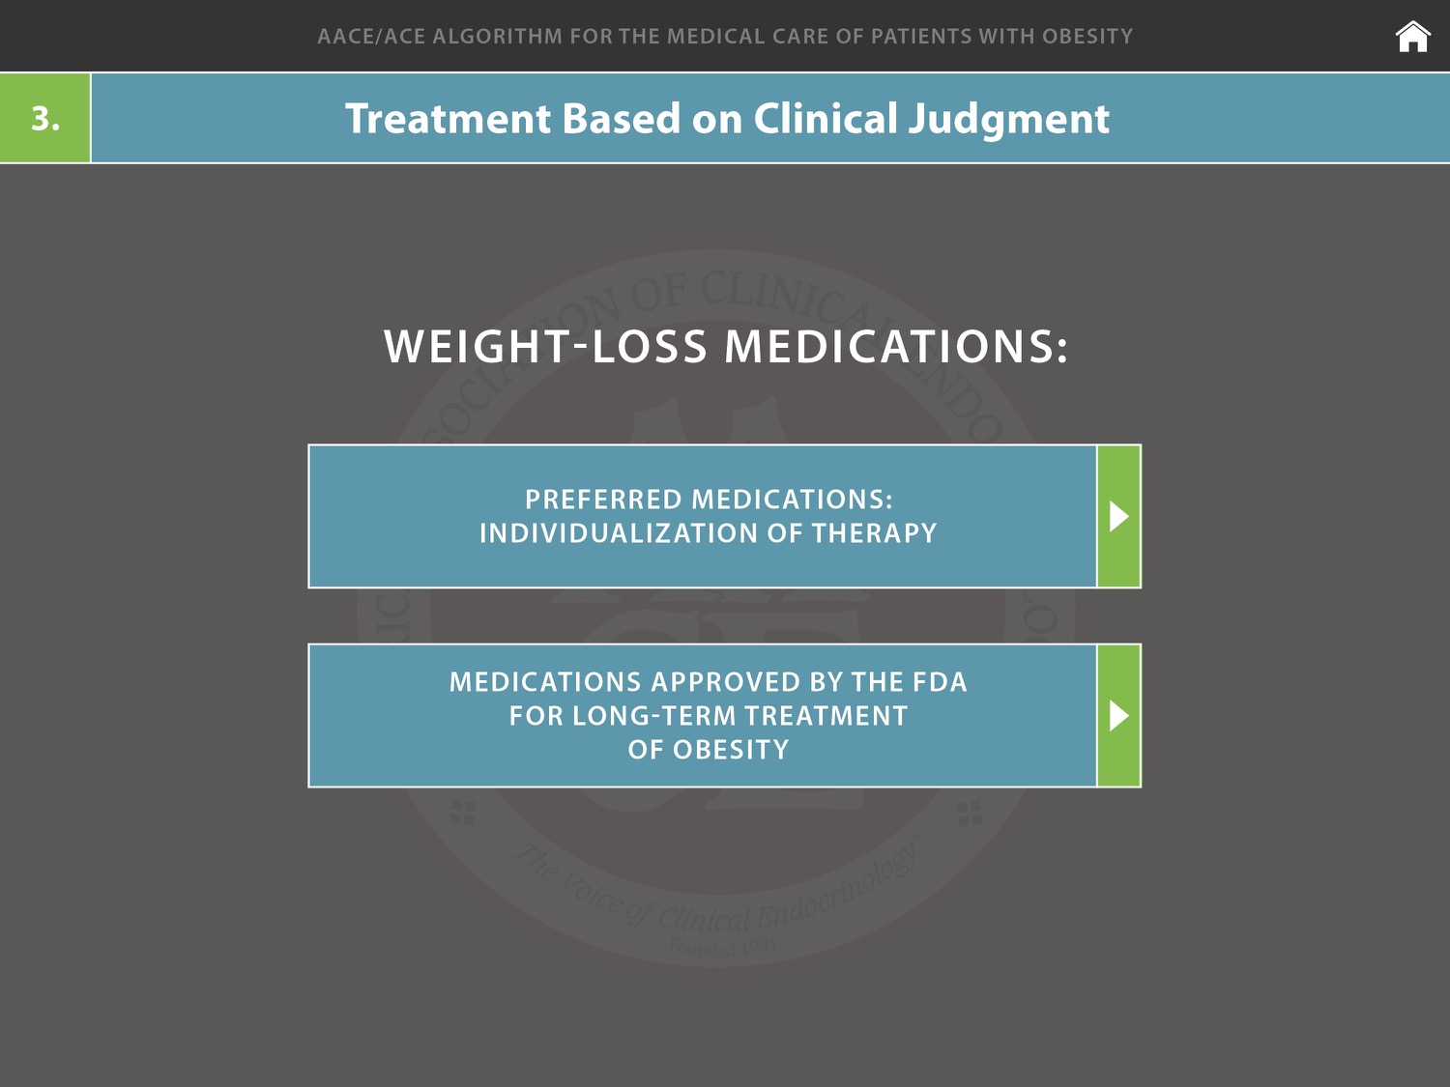

Slide 35
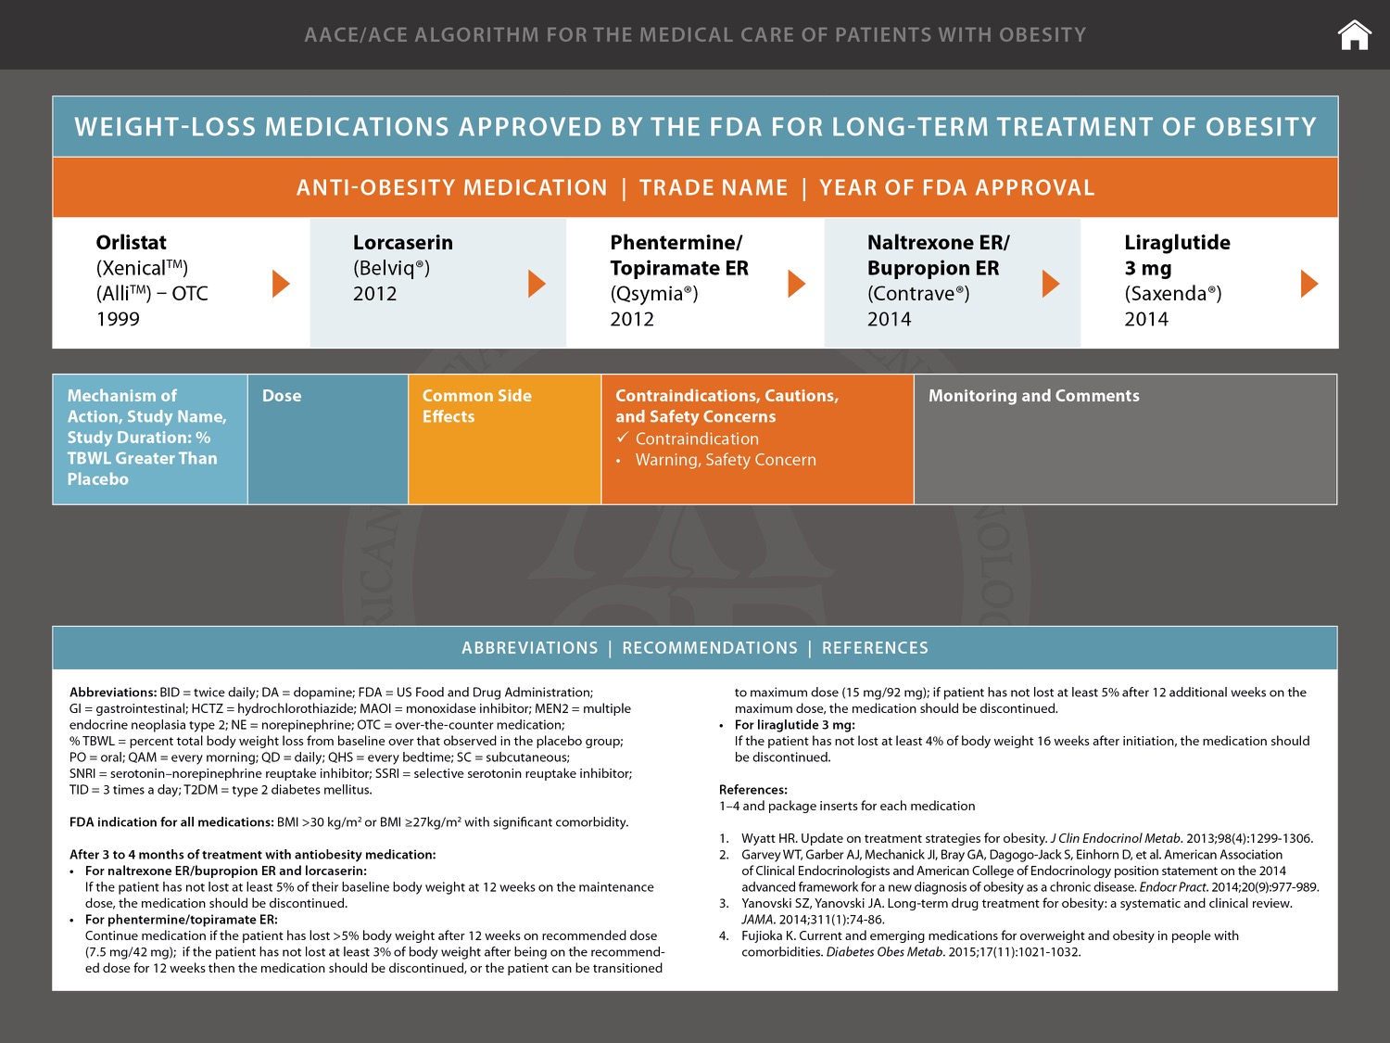

Slide 36
Comparative Efficacy of Weight-Loss Medications
Percentage Weight Loss From Baseline After 1 Year*
Phentermine/
Topiramate
Liraglutide
3 mg
Naltrexone/ Bupropion
Lorcaserin
Orlistat
Phentermine
BLOOM-DM
BLOSSOM
EQUATE
(15 mg, 24 weeks)
Δ Weight (%)
BLOOM
XENDOS
COR-I
Astrup
et al.
SCALE Maintenance
COR-II
Munro et al. (completers)
CONQUER
SEQUEL
(2-year data)
EQUIP
*All data placebo-subtracted, maximal dose, ITT-LOCF at 1 year, unless otherwise indicated.
ITT = intent to treat; LOCF = last observation carried forward.
Garvey WT. Endocr Pract. 2013;19:864-874. Wadden TA, et al. Int J Obes (Lond). 2013;37:1443-1451. Apovian CM, et al. Obesity (Silver Spring). 2013;21:935–943.

Slide 37
How Do We Treat Obesity?
Bariatric Surgery

Slide 38
Surgery Options
Bariatric Surgery

Slide 39
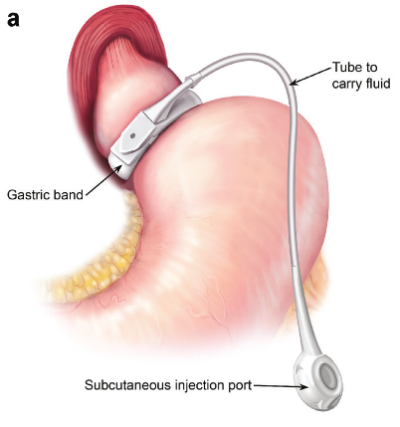
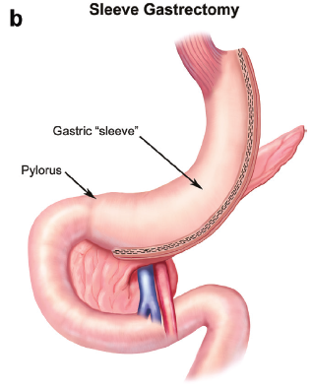
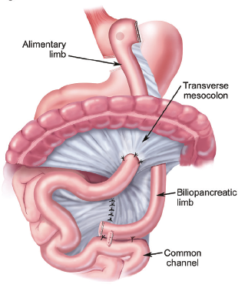
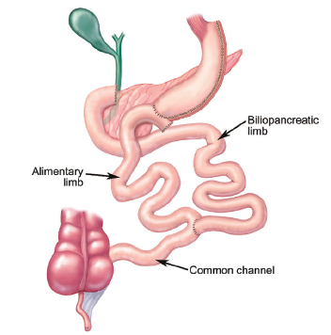
Surgical Options
Laparoscopic Adjustable
Gastric Band (LABG)
Laparoscopic Sleeve
Gastrectomy (LSG)
Roux-en-Y Gastric Bypass (RYGB)
Biliopancreatic Diversion
with Duodenal Switch
Mechanick JI, et al. Endocr Pract. 2013;19:337-372.

Slide 40

Notes:
40
40
40
40
40

Slide 41



Gracias...

